Slide 1
Foliowatch
Where you pretend you’re buying but you’re actually not :D

Slide 2
Table of contents
Introduction
System Architecture
1
2
Goals and objectives
Use case diagram, UML, ERD
Libraries
Product Demonstration
3
4
Resources used for this project
Unique Features
Demonstration of our app
Notes:
Introduction
System Architecture
Libraries
Product Demonstration

Slide 3

1
Introduction

Slide 4
Objectives
Documentation for hand over purposes
Creation and Update of Portfolio
Portfolio
documentation
Registration process
Display
Display of portfolio with analytics
Email Verification
Password restriction checks

Slide 5

2
Architecture

Slide 6



System Architecture
users
React
Front end
Controller layer
SpringBoot
Service layer
SpringBoot
Repository layer
SpringBoot
Database
MongoDB

Slide 7
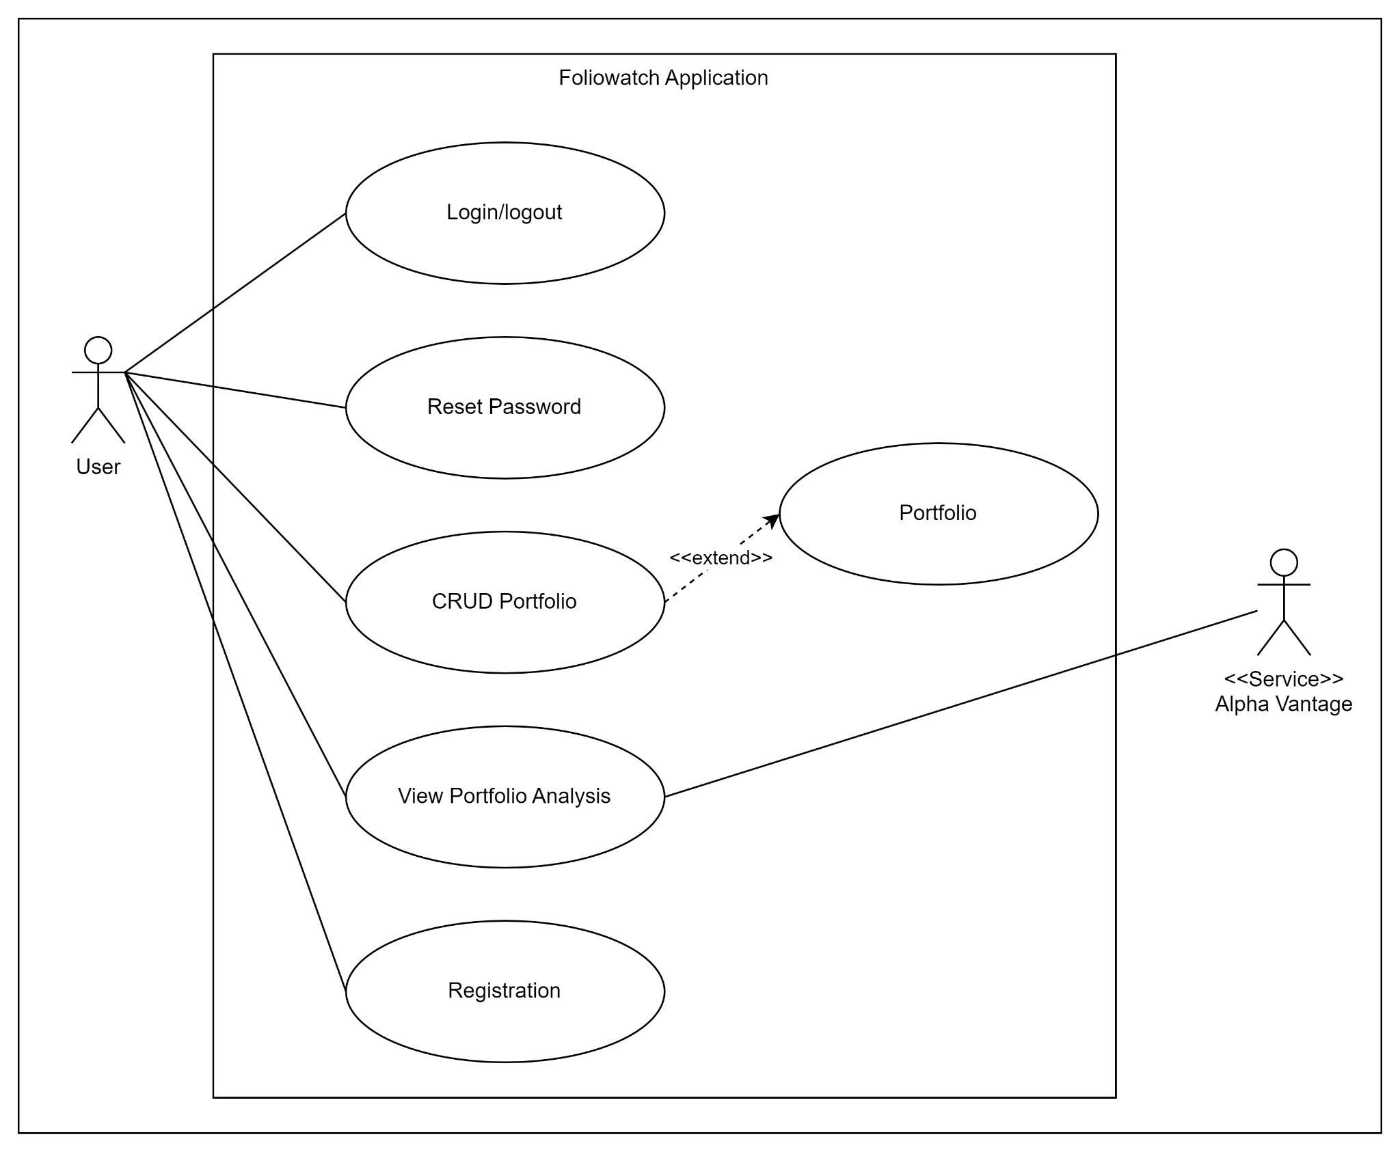
Use Case Diagram

Slide 8
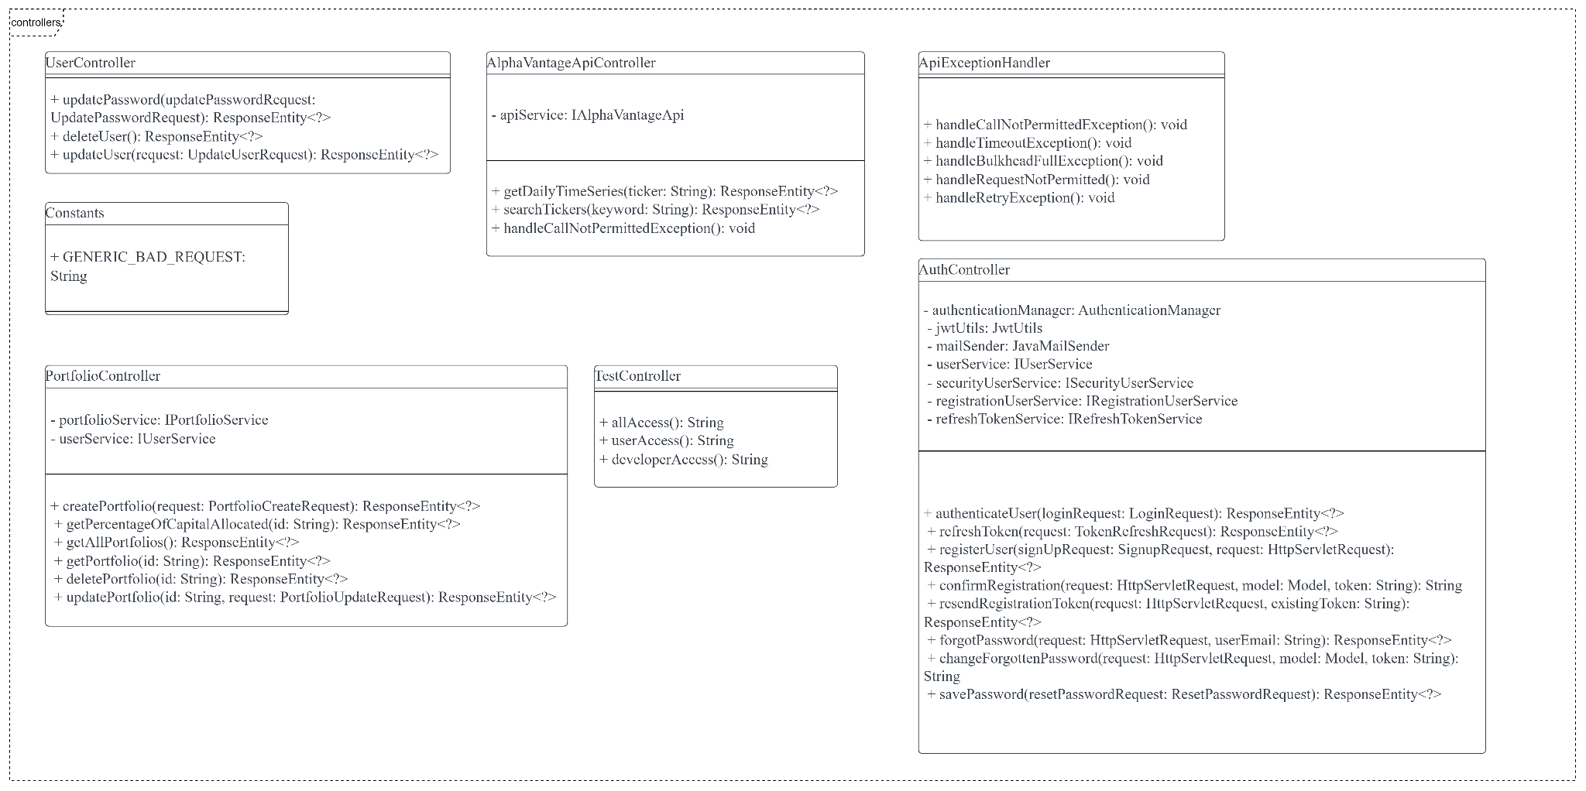
Class Diagram

Slide 9
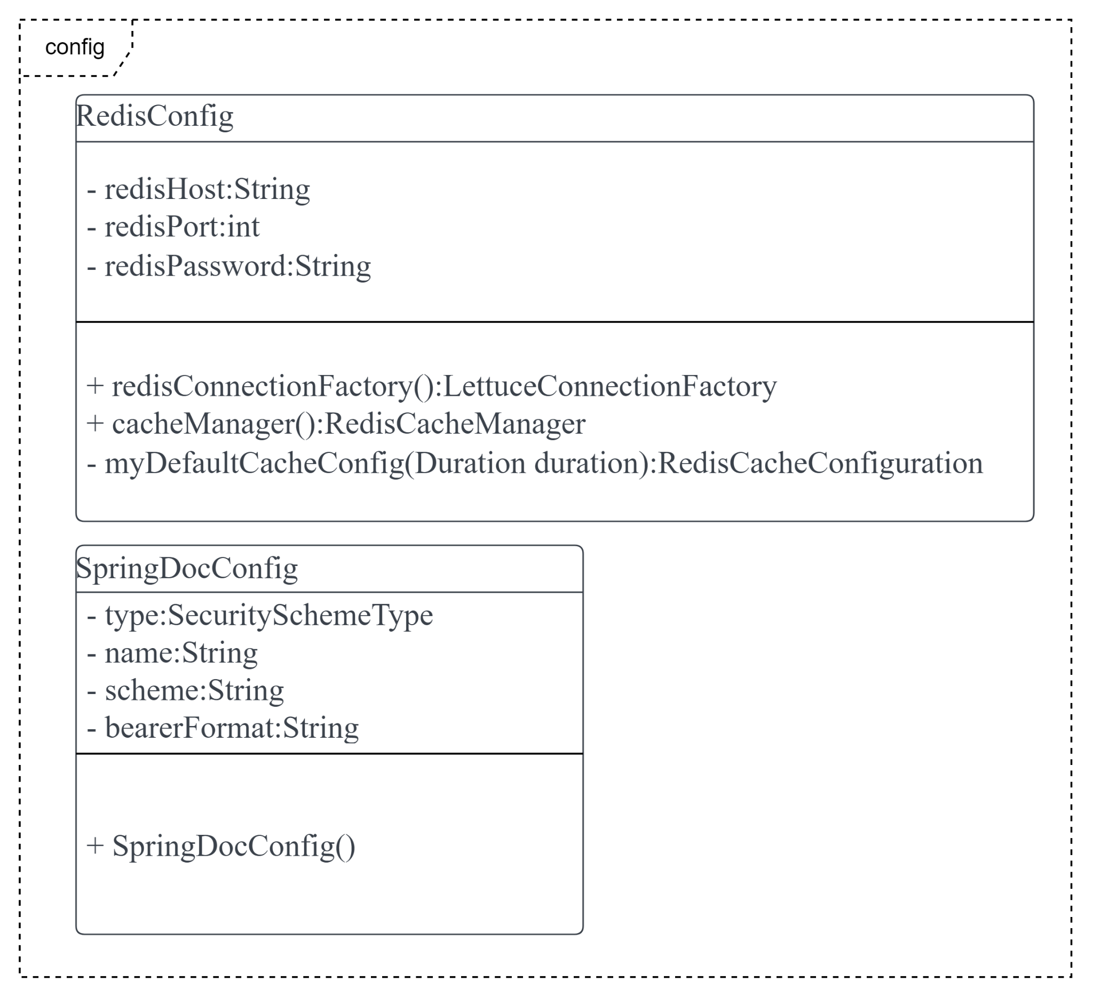
Class Diagram

Slide 10
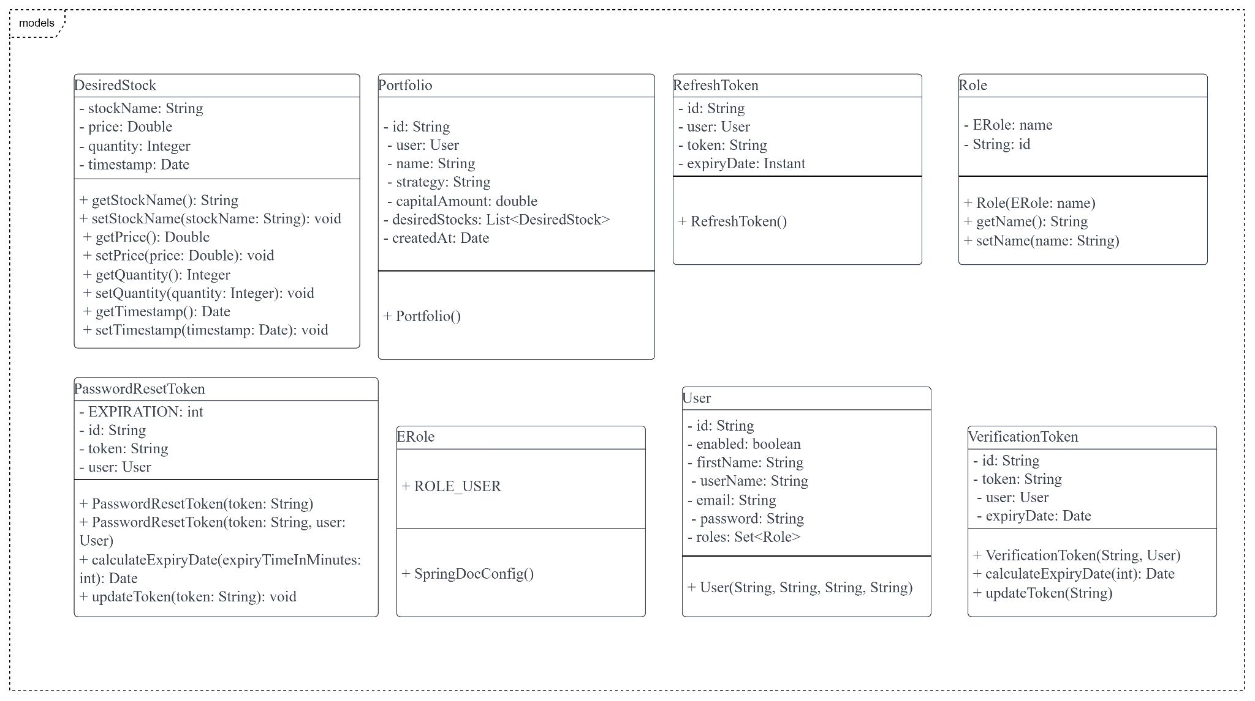
Class Diagram

Slide 11
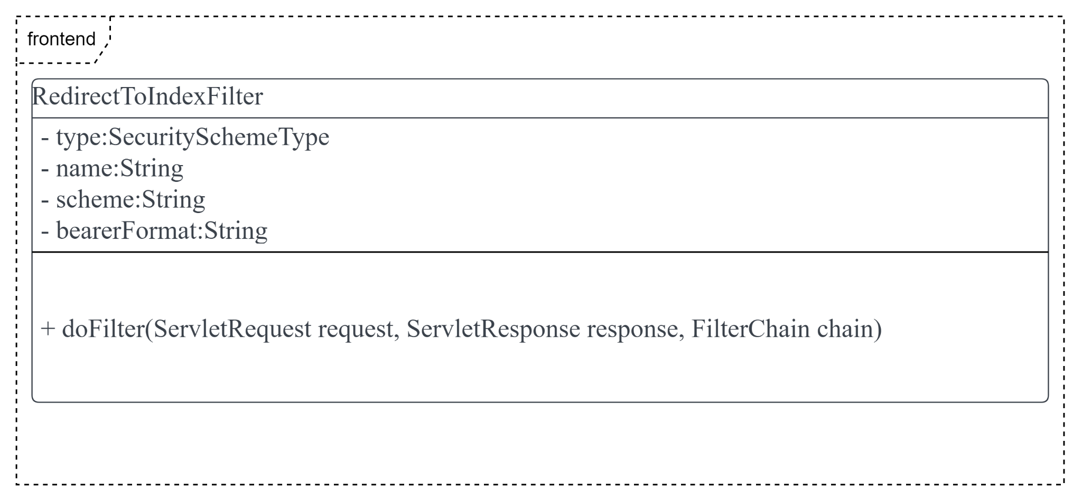
Class Diagram

Slide 12
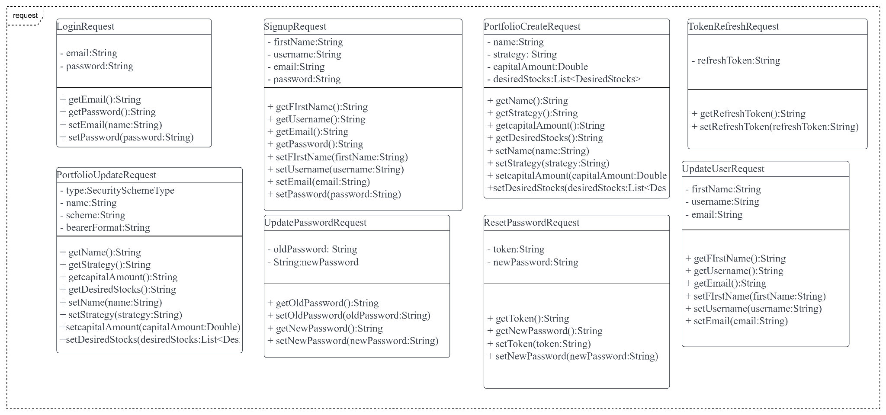
Class Diagram

Slide 13
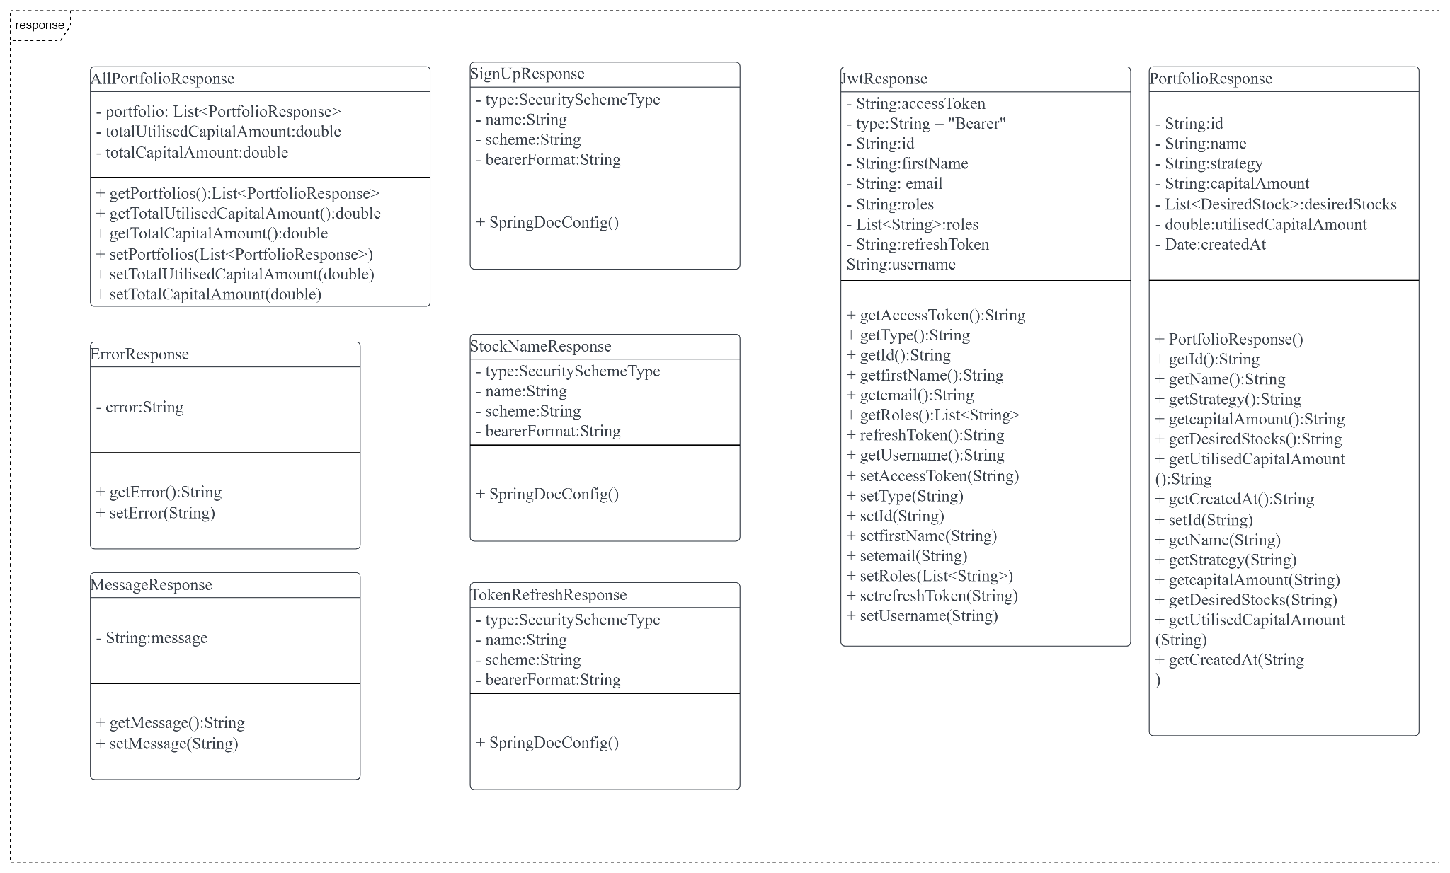
Class Diagram

Slide 14
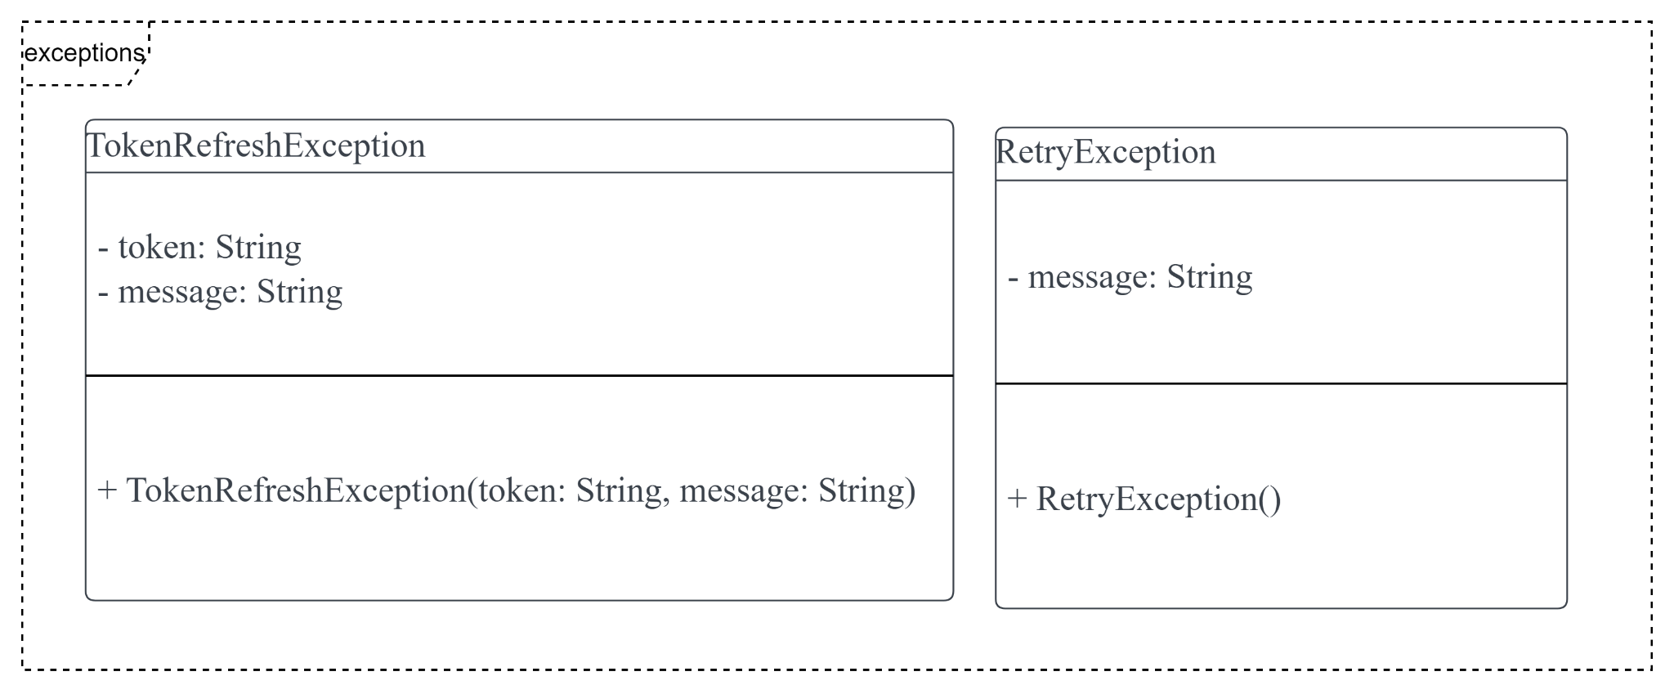
Class Diagram

Slide 15
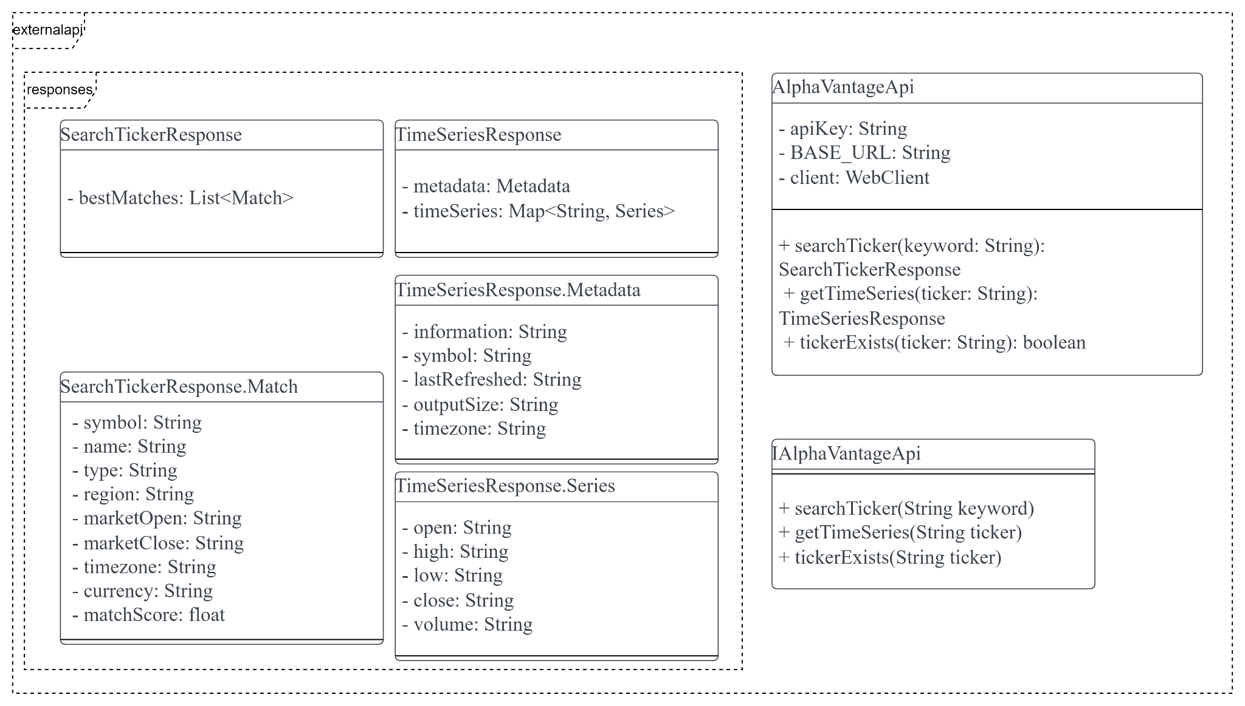
Class Diagram

Slide 16
3
Libraries

Slide 17
Frontend
Libraries | Description
Figma | UI/UX prototyping and design
React, Material UI | Code for website logic

Slide 18
Backend
Libraries | Description
MongoDB, Redis, Spring Cache Abstraction | Data Storage
Spring Validator | Input Validation
Spring Boot, Maven | Application Technologies
JSON Web Token, Spring Security | Security
SpringDoc | OpenAPI Documentation
Thymeleaf | HTML Templating Library
Resilience4J | Short circuiting and retry with exponential backoff

Slide 19
4
Unique Features & Demo

Slide 20
Unique Features
Libraries | Description
API Documentation Code Generation | Generating API fetching code from OpenAPI schema
API Short-Circuiting | Once a certain number of failure requests to the AlphaVantage API occurs, it avoids making further requests to the API using Resilience4J
API Documentation | A collection of references, tutorials, and examples that help developers use your API

Slide 21

Demo
Link: https://github.com/oop-group7/portfolio-main
Notes:
User EXP journey
Forgot password feature
API documentation
Not sure
Show source code and some of the libraries we mentioned?

Slide 22
Thank you!

